Slide 1

Faculty of Engineering and Technology
Parul Institute of Technology
Department of Computer Science & Engineering
Course: B.Tech – CSE
Subject: Database Management System

Slide 2
Unit 2
SQL

Slide 3
:Overview:
DDL : Data Definition Language
DQL : Data Query Language
DML : Data Manipulation Language
DCL : Data Control Language
WHERE and LIKE
Aggregate Functions
Logical Operators: AND, OR
BETWEEN, IN, NOT IN
UNION, INTERSECT, MINUS
Date Functions
Character Functions
Arithmetic Functions

Slide 4
DDL : Data Definition Language
DDL is a set of SQL commands used to create, modify and delete database structures but not data.
List of DDL Commands:
CREATE : It is used to create a new table in database.
ALTER : It is used to change the structure or definition of a created table. We can add, remove or change the particular column name using ALTER. We can change table name also.

Slide 5
CREATE Command
Syntax:
CREATE TABLE table_name
(column1_name data type for column1,
column2_name data type for column2,
…
columnN_name data type for column N);
Example:
CREATE TABLE student
(Enrollment Number int,
Name varchar,
Contact Number varchar,
City varchar);
Output: This will create a table having four columns.

Slide 6
ALTER Command for adding column
Syntax:
ALTER TABLE table_name
ADD
column1_name data type for column1, column2_name data type for column2,
…
columnN_name data type for columnN ;
Example:
ALTER TABLE Student
ADD
Email ID varchar;
Output: This will add a new column named ‘Email ID’ into created table ‘Student’. Now this table contains five columns.

Slide 7
ALTER Command for deleting column
Syntax:
ALTER TABLE table_name
DROP
column1_name data type for column1, column2_name data type for column2,
…
columnN_name data type for columnN ;
Example:
ALTER TABLE Student
DROP
Email ID varchar;
Output: This will remove a new column named ‘Email ID’ from created table ‘Student’. Now this table contains four columns.

Slide 8
ALTER Command for renaming column
Syntax:
ALTER TABLE table_name
RENAME COLUMN existing name TO new name;
Example:
ALTER TABLE Student
RENAME COLUMN Enrollment Number TO EnNo;
Output: This will rename a new column named ‘Enrollment Number’. New name of this particular name will be ‘EnNO’.

Slide 9
ALTER Command for renaming table
Syntax:
ALTER TABLE table_name
RENAME new name of existing table;
Example:
ALTER TABLE Student
RENAME Student1;
Output: This will rename existing table as ‘Student1’.

Slide 10
DQL : Data Query Language
DQL is a SQL command used to fetch required data from the database.
SELECT is a DQL command.

Slide 11
SELECT Command for fetching all columns
Syntax:
SELECT * FROM table_name;
Example:
SELECT * FROM Student;
Output: This will show entire Student table.

Slide 12
SELECT Command for fetching selected columns
Syntax:
SELECT
column_name 1,
column_name 2,
…
column_name n
FROM table_name;
Example:
SELECT Name, City FROM Student;
Output: This will show only two columns of Student table.

Slide 13
DML : Data Manipulation Language
DML is a set of SQL commands used to manipulate data.
List of DML Commands:
INSERT : It is used to insert values into a created table in database.
UPDATE : It is used to change the values in a created table.
DELETE : It is used to remove the records or values from the table.

Slide 14
INSERT Command
Syntax:
INSERT INTO table_name VALUES
(value 1, value 2, … value N);
Example:
INSERT INTO Student VALUES
(1, ‘Aakash’,’Shah’, 20,’aakashshah@gmail.com’),
(2, ‘Sagar’,’Patel’, 21,’sagarpatel@gmail.com’);
Output: This will insert two rows into the created Student table.

Slide 15
UPDATE Command
Syntax:
UPDATE table_name
SET
column1_name=value1,
column2_name=value2,
…
columnn_name=valuen
WHERE condition;
Example:
UPDATE Student
SET
City=‘Vadodara’
WHERE Enrollment Number=1;
Output: This will update city’s name ‘Vadodara’ for the particular record having Enrollment Number 1.

Slide 16
DELETE Command
Syntax:
DELETE FROM table_name
WHERE condition;
Example:
DELETE FROM Student
WHERE Enrollment Number=1;
Output: This will delete the particular row having record having Enrollment Number 1.

Slide 17
DCL : Data Control Language
DCL is a set of SQL commands used to control the access data stored in a database.
List of DML Commands:
GRANT :
REVOKE:

Slide 18
How to create a User?
Syntax:
CREATE USER user_name
WITH PASSWORD ‘password_value’ | VALID UNTIL ‘expiration’;
Examples:
CREATE USER abc
WITH PASSWORD ‘abc1234’ | VALID UNTIL ‘Jan 1, 2020’;
CREATE USER def
WITH PASSWORD ‘def1234’ | VALID UNTIL ‘infinity’;

Slide 19
How to delete a User?
Syntax:
DROP USER user_name;
Example:
DROP USER abc;

Slide 20
How to rename a User?
Syntax:
ALTER USER user_name TO new_name;
Examples:
ALTER USER abc TO abc1;

Slide 21
GRANT
Syntax:
GRANT privileges ON table_name TO user;
Examples:
GRANT SELECT, INSERT, UPDATE, DELETE ON Student TO abc;
User “abc” can perform select, insert, update and delete on the table “Student”.
GRANT ALL ON Student TO def;
User “def” can perform all operations on the table “Student”.
GRANT SELECT ON Student TO PUBLIC;
Any user can perform only select operations on the table “Student”.

Slide 22
REVOKE
Syntax:
REVOKE privileges ON table_name FROM user;
Examples:
REVOKE ALL ON Student FROM abc;
Permissions are taken back from user “abc”.

Slide 23
WHERE
The WHERE predicate is used for filter the records.
It is used to extract only those records that fulfil a specified condition.
Syntax:
SELECT
column1_name, column2_name, … columnN_name
FROM table_name
WHERE condition;

Slide 24
WHERE
Examples:
SELECT First_Name FROM student WHERE age<20;
SELECT First_Name, Last_Name FROM student WHERE age<20;
SELECT First_Name, Last_Name FROM student WHERE city=‘Baroda’;

Slide 25
LIKE
The LIKE operator is used in a WHERE predicate to search for a specified pattern in a column.
There are two wildcards often used with LIKE: % and _
A% means string starts with A. Example: AB or ABC or ABCDE.
%A means any string that ends with A. Example: BA or CBA.
A%B means string starts with A but ends with B. Example: ACGB or ADB.
AB_C means string starts with AB then there is any one character and at last there is C.
A_C means string starts with A then there is any one character and at last there is C.
A_ means string starts with A then there is any one character at the end.

Slide 26
LIKE
Syntax:
SELECT
column1_name, column2_name, … columnN_name
FROM table_name
WHERE condition
LIKE pattern;

Slide 27
LIKE
Examples:
SELECT First_Name FROM student WHERE age<20 LIKE ‘P%’;
SELECT First_Name FROM student WHERE age>25 LIKE ‘M%’;
SELECT First_Name FROM student WHERE age>25 LIKE ‘P%K’;
SELECT First_Name FROM student WHERE age>25 LIKE ‘%K’;
SELECT First_Name FROM student WHERE age>25 LIKE ‘_A%’;

Slide 28
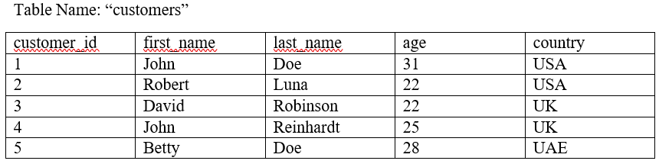
Aggregate Functions
The aggregate function simply refers to the calculations performed on a data set to get a single number.
Some common aggregate functions include:
COUNT
SUM
AVG
MIN
MAX
Consider the following table. We will perform functions on this table.

Slide 29
COUNT Function
Syntax:
SELECT COUNT (column_name) FROM table_name WHERE condition LIKE pattern;
Examples:
SELECT COUNT (fisrt_name) FROM customers WHERE age<25;
Output: 2
SELECT COUNT (fisrt_name) FROM customers WHERE first_name LIKE ‘J%’;
Output: 2
SELECT COUNT (customer_id) FROM customers;
Output: 5
SELECT COUNT (customer_id) FROM customers WHERE country= ‘USA’;
Output: 2

Slide 30
SUM Function
Syntax:
SELECT SUM (column_name) FROM table_name WHERE condition LIKE pattern;
Examples:
SELECT SUM (age) FROM customers WHERE age<25;
Output: 44
SELECT SUM (age) FROM customers WHERE first_name LIKE ‘J%’;
Output: 56
SELECT SUM (customer_id) FROM customers;
Output: 15
SELECT SUM (age) FROM customers WHERE country= ‘USA’;
Output: 53

Slide 31
AVG Function
Syntax:
SELECT AVG (column_name) FROM table_name WHERE condition LIKE pattern;
Examples:
SELECT AVG (age) FROM customers WHERE age<25;
Output: 25.6
SELECT AVG (age) FROM customers WHERE first_name LIKE ‘J%’;
Output: 28
SELECT AVG (customer_id) FROM customers;
Output: 3
SELECT AVG (age) FROM customers WHERE country= ‘USA’;
Output: 26.5
5. SELECT AVG (age*10) FROM customers WHERE country= ‘USA’;
Output: 265

Slide 32
MIN Function
Syntax:
SELECT MIN (column_name) FROM table_name WHERE condition LIKE pattern;
Examples:
SELECT MIN (age) FROM customers;
Output: 22
SELECT MIN (age) FROM customers WHERE first_name LIKE ‘J%’;
Output: 25
SELECT MIN (customer_id) FROM customers;
Output: 1
SELECT MIN (age) FROM customers WHERE country= ‘USA’;
Output: 22

Slide 33
MAX Function
Syntax:
SELECT MAX (column_name) FROM table_name WHERE condition LIKE pattern;
Examples:
SELECT MAX (age) FROM customers;
Output: 28
SELECT MAX (age) FROM customers WHERE first_name LIKE ‘J%’;
Output: 31
SELECT MAX (customer_id) FROM customers;
Output: 5
SELECT MAX (age) FROM customers WHERE country= ‘USA’;
Output: 31

Slide 34
Logical Operators
Logical operators are used along with the different conditions. AND and OR are logical operators.
Consider the following table. We will perform functions on this table.

Slide 35
Logical Operators
Examples:
SELECT * FROM customers WHERE age=22 AND first_name=‘David’;
SELECT * FROM customers WHERE age=22 OR first_name=‘David’;
SELECT * FROM customers WHERE country=‘UK’ AND (age=22 OR first_name=‘David’);

Slide 36
BETWEEN
The SQL BETWEEN condition allows you to easily test if an expression is within a range of inclusive values.
The values can be text, date, or numbers. It can be used in a SELECT, INSERT, UPDATE, or DELETE statement.
Syntax:
SELECT
column1_name, column2_name, … columnN_name
FROM table_name
WHERE condition
BETWEEN value1 AND value2;
It will return the records where the expression is within the range of value1 and value2.

Slide 37
BETWEEN
Example 1:
SELECT * FROM customers
WHERE age
BETWEEN 25 AND 30;
Example 2:
SELECT * FROM customers
WHERE age
NOT BETWEEN 25 AND 30;

Slide 38
IN and NOT IN
IN operator allows you to easily test if the expression matches any value in the list of values.
It is used to remove the need for multiple OR conditions in SELECT, INSERT, UPDATE, or DELETE.
You can also use NOT IN to exclude the rows in your list.
Syntax:
SELECT
column1_name, column2_name, … columnN_name
FROM table_name
WHERE condition
IN (value1, value2, …, value n);

Slide 39
IN and NOT IN
Example 1:
SELECT * FROM customers
WHERE age IN (22,28);
Example 2:
SELECT * FROM customers
WHERE age NOT IN (22,28);

Slide 40
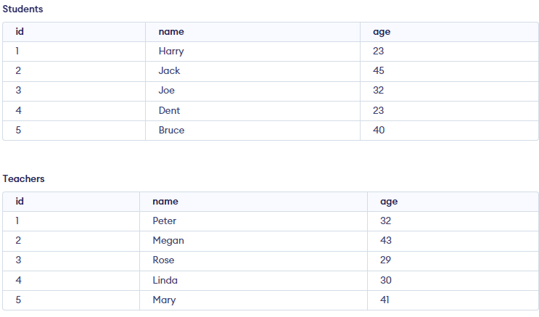
UNION
Consider the following tables. We will perform union operation on these tables.

Slide 41

UNION
SELECT Name FROM Teachers
UNION
SELECT Name FROM Students;
Output

Slide 42
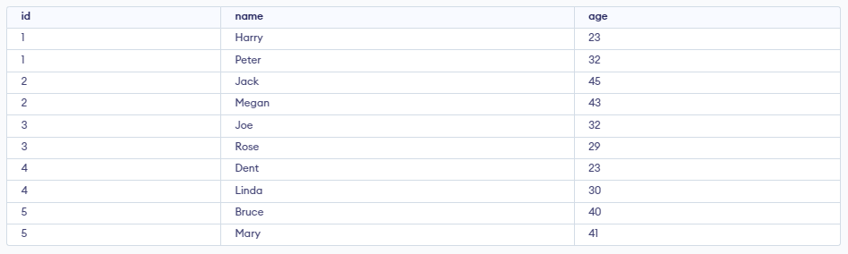
UNION
SELECT * FROM Teachers
UNION
SELECT * FROM Students;
Output

Slide 43
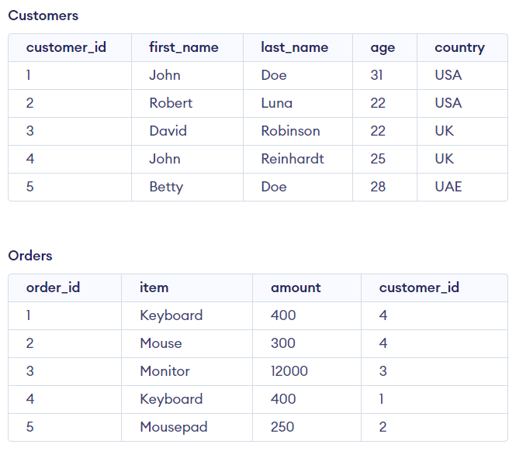
INTERSECTION
Consider the following tables. We will perform union operation on these tables.

Slide 44
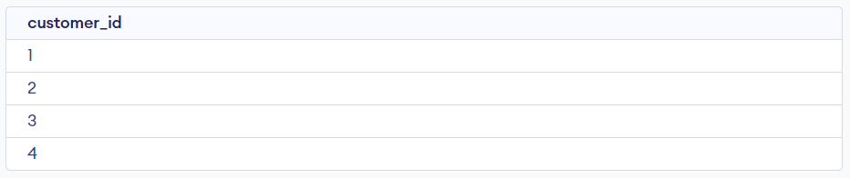
INTERSECTION
SELECT customer_id FROM Customers
INTERSECT
SELECT customer_id FROM Orders;
Output

Slide 45
MINUS
Consider the following tables. We will perform union operation on these tables.

Slide 46
MINUS
SELECT customer_id FROM Customers
MINUS
SELECT customer_id FROM Orders;
Output

Slide 47



Date Functions
1. SELECT Current_date;
This command will show date in form of YYYY-MM-DD.
2. SELECT Current_time;
This command will show current time.
3. SELECT Current_timestamp;
This command will show current time and date.

Slide 48
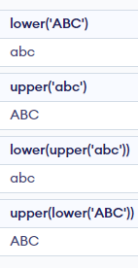

Character Functions
Select lower('ABC’);
Select upper('abc’);
Select lower(upper('abc'));
Select upper(lower('ABC’));
Select length(‘Hello Good Morning’);
Output

Slide 49
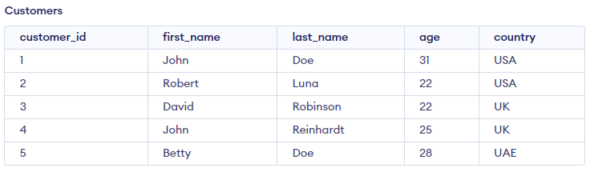
Arithmetic Functions
Consider the following table for arithmetic operations.

Slide 50
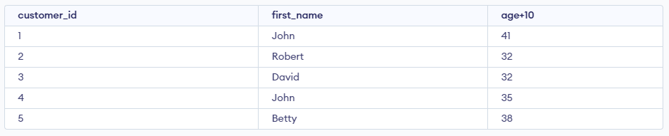
Addition
Select customer_id, first_name, age+10 AS "age+10" from Customers;

Slide 51
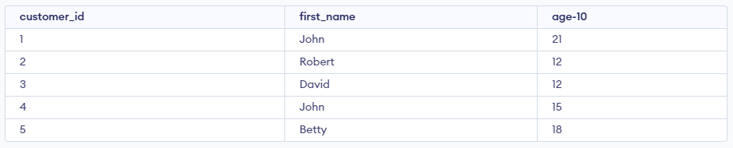
Subtraction
Select customer_id, first_name, age-10 AS "age-10" from Customers;

Slide 52
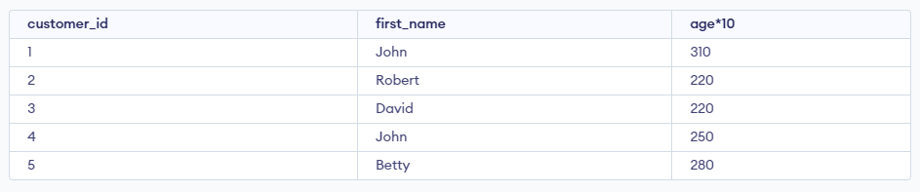
Multiplication
Select customer_id, first_name, age*10 AS "age*10" from Customers;

Slide 53
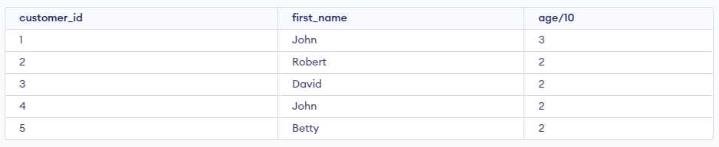
Division
Select customer_id, first_name, age/10 AS "age/10" from Customers;

Slide 54
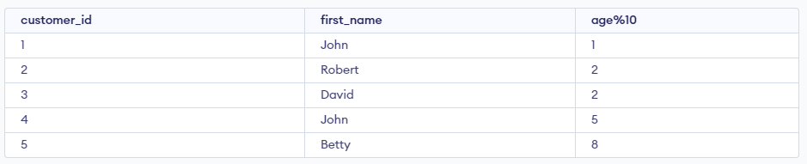
Modulus
Select customer_id, first_name, age%10 AS "age%10" from Customers;

Slide 55
Some other functions
1. PI function:
Select PI ();
Output => 3.141592653589793
2. SQRT function:
Select SQRT (100);
Output => 10
3. SQUARE function:
Select SQUARE (5);
Output => 25
4. SQRT function:
Select SQRT (100);
Output => 10
5. Round function:
Select ROUND (213.456, 2);
Output => 213.46
Select ROUND (213.456, 1);
Output => 213.5
6. CEIL function:
Select ceil(23.34);
Output => 24
7. FLOOR function:
Select floor(23.34);
Output => 23
8. POWER function:
Select power(2,3);
Output => 8

